Slide 1
Homologous and Analagous Structures

Slide 2
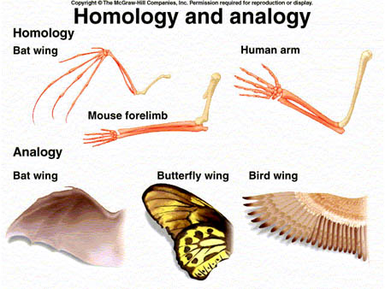
Comparative Morphology Analogous Structures
Structures with similar function but different internal structure, development (bird wing and insect wings, dolphin fin and shark fin)
Does NOT show evolutionary relationships
Why similar in structure?

Slide 3
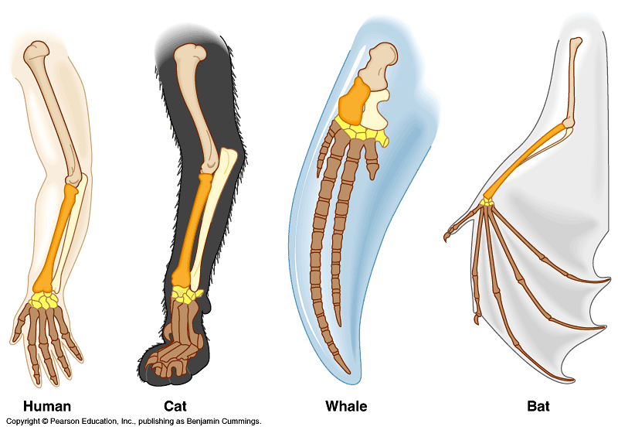
Comparative Morphology- Homologous Structures
Structural similarities among organism
Homologous structures – similar structure, different function (dog leg, whale flipper, Bird wing)
Shows evolutionary relationship, origin

